Slide 1
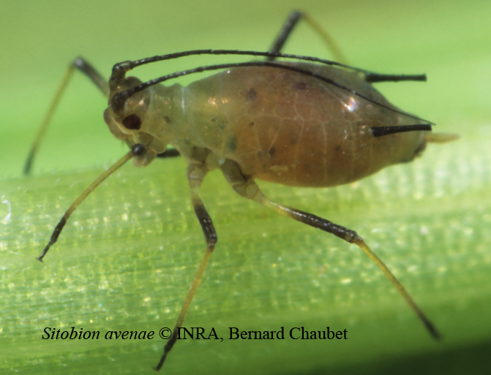
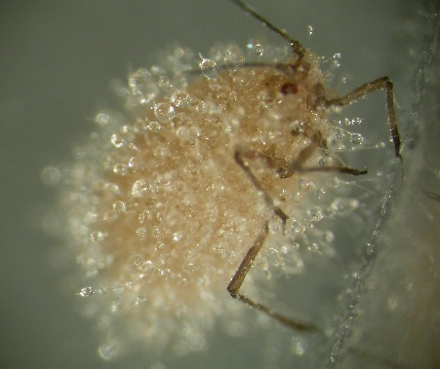
The population dynamics of Sitobion avenae in presence of its natural enemy Pandora neoaphidis in winter wheat
Phytobiomes and plant health: from basics to application, January 23-25, 2019
Stéphanie Saussure^{1,2*}, Anne-Grete Roer Hjelkrem¹, Richard Meadow^{1,2}, Ingeborg Klingen¹, Niels Holst³
¹ Norwegian Institute of Bioeconomy Research (NIBIO), Ås, Norway.
² Norwegian University of Life Sciences (NMBU), Ås, Norway.
³ Aarhus University, Flakkebjerg, Denmark.

Slide 2

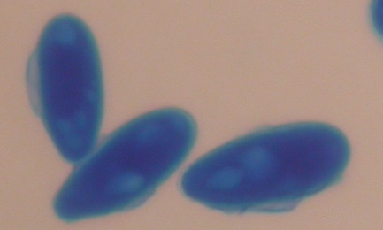
The system
Sitobion avenae: the pest
Pandora neoaphidis: the natural enemy
The English grain aphid: all over Europe
Cause direct damage and transmit viruses
Attack cereals and grasses
Biggest disease in aphids: fungal pathogen
Need its host alive (biotrophic)
Result in epizootic and collapse of aphid population
Pandora spp. spores (x800)

Slide 3
Biological cycles and important characteristics
Sitobion avenae and Pandora neoaphidis

Slide 4
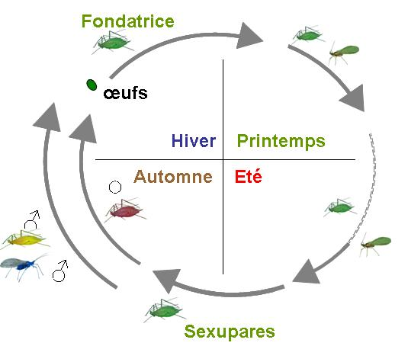
Simplified aphid’s biological cycle
Fondatrices: mature wingless stem mother. (Hatch from overwintering eggs)
eggs
Parthenogenetic females. Winged and apterous females produce depending on environmental conditions.
Winter
Spring
Fall
Summer
Sexuparae: the progeny of the stem mother, males and females
Inspired from Encyclop'Aphid INRA

Slide 5
Simplified aphid’s biological cycle
Fondatrices: mature wingless stem mother. (Hatch from overwintering eggs)
eggs
Parthenogenetic females.
- Winged and apterous females
- Ratio depends on environmental conditions.
Winter
Spring
Fall
Summer
Sexuparae: the progeny of the stem mother, males and females
Inspired from Encyclop'Aphid INRA

Slide 6
Simplified aphid’s biological cycle
Fondatrices: mature wingless stem mother. (Hatch from overwintering eggs)
eggs
Parthenogenetic females.
- Winged and apterous females
- Ratio depends on environmental conditions.
Winter
Spring
Fall
Summer
Sexuparae: stem mother’s progeny:
males and females
Inspired from Encyclop'Aphid INRA

Slide 7
Simplified aphid’s biological cycle
Fondatrices: mature wingless stem mother. (Hatch from overwintering eggs)
eggs
Parthenogenetic females.
- Winged and apterous females
- Ratio depends on environmental conditions.
Winter
Spring
Fall
Summer
Sexuparae: stem mother’s progeny:
males and females
Inspired from Encyclop'Aphid INRA

Slide 8
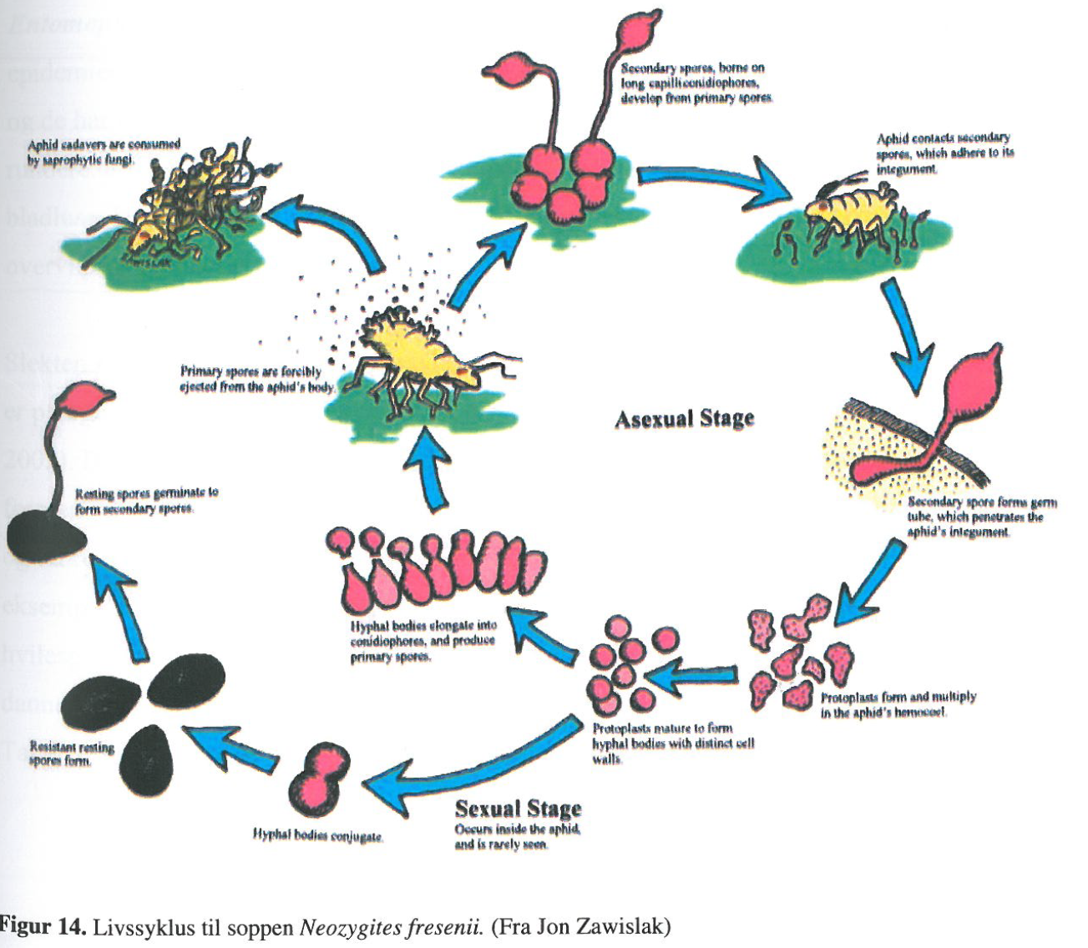
Entomophthoromycota’s biological cycle
Aphid cadaver consumed by saprophytic fungi
Conidia
Conidia adhere to the cuticle
Projection of primary conidia
Resting spores germinate to form secondary spores.
Germination and penetration through the cuticle
Hyphal bodies elongate into conidiophores and produce primary spores.
Protoplasts multiply
Resting spores form
Formation of hyphal bodies
Hyphal bodies conjugate

Slide 9
Entomophthoromycota’s biological cycle
Overgrowth of saprophytic fungi
Conidia
Conidia adhere to the cuticle
Projection of primary conidia
Germination and penetration through the cuticle
Elongation of hyphal bodies & conidiophores
Protoplasts multiply
Resting spores form
Formation of
hyphal bodies

Slide 10
Entomophthoromycota’s biological cycle
Overgrowth of saprophytic fungi
Conidia
Conidia adhere to the cuticle
Projection of primary conidia
Germination and penetration through the cuticle
Protoplasts multiply
Resting spores
Formation of
hyphal bodies
Hyphal bodies conjugate

Slide 11
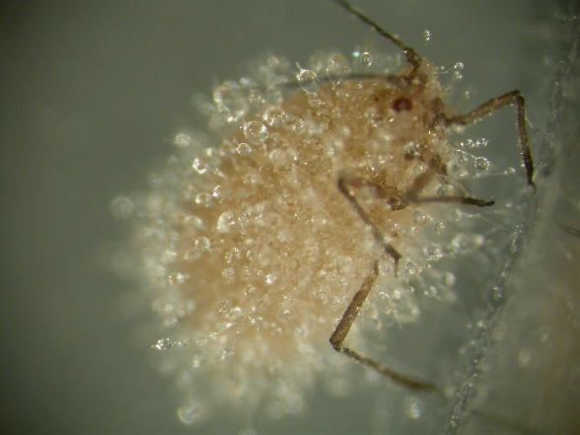
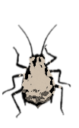
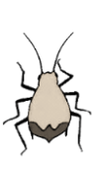
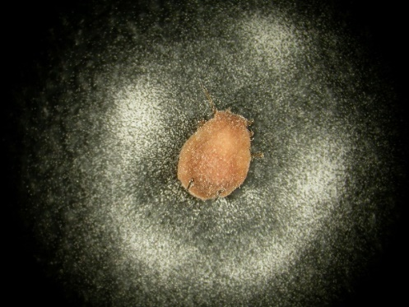
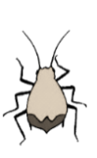

How it occurs in the field
Grasses
and cereal crops
From Eilenberg et al. (in prep)
Pandora spp. spores (x800)

Slide 12
The model structure
Three sub-models

Slide 13
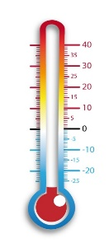

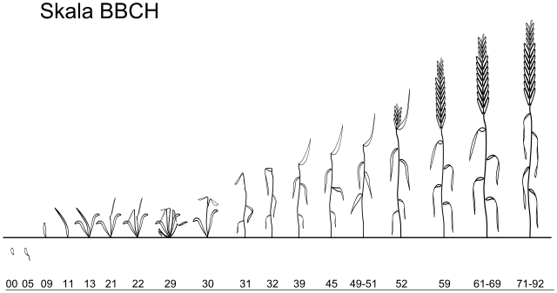
Winter wheat sub-model

Slide 14
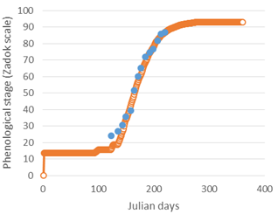
Winter wheat sub-model
Observation
Prediction

Slide 15
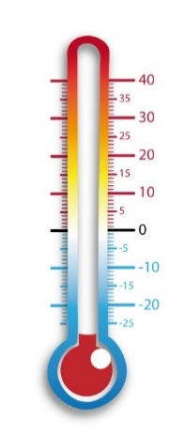
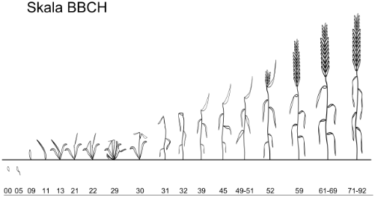
Aphid sub-model
Immigrant winged adults
Apterous nymphs
Apterous adults
reproduction

Slide 16
Aphid sub-model
Immigrant winged adults
Apterous nymphs
Apterous adults
Ratio winged/apterous
reproduction
Winged nymphs
Winged adults
emigration

Slide 17
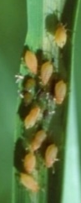

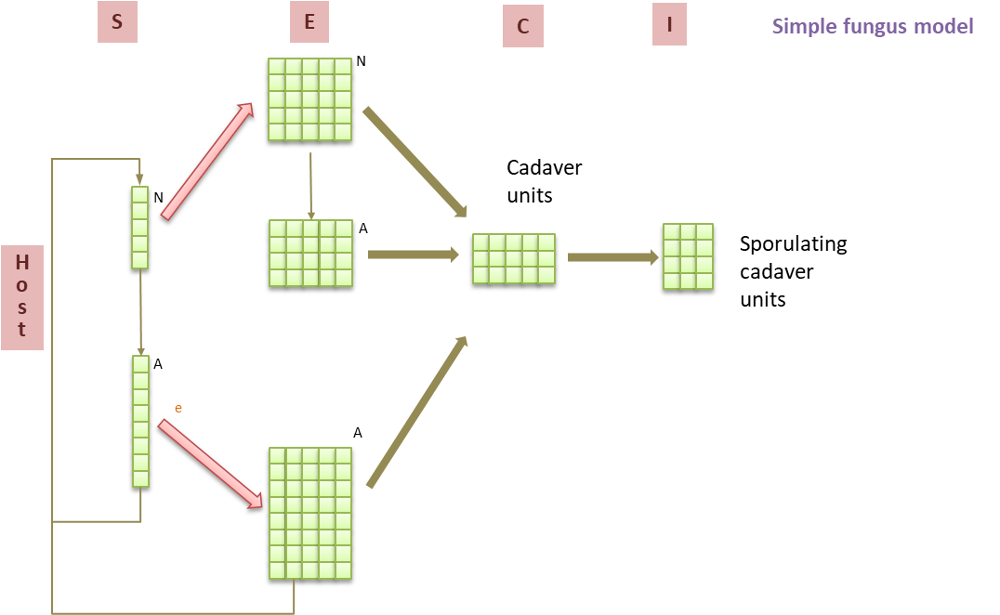
Fungus sub-model

Slide 18
Research questions
Which parameters of the fungus biology and ecology are the most important to enable an epizootic?
How much the weather influence the probability of an epizootic?

Slide 19
1. Most important parameters:
Aphids parameters set to enable a pest outbreak unless controlled by the fungus
Sensitivity analysis

Slide 20
Nine parameters related to fungus biology and ecology
Parameters | Range of values | References
Fungus Biology
RH threshold (%) | 70 – 95 | Sawyer et al. 1997, Castro et al. 2018
Longevity of non-sporulating cadavers (degree-day) | 54 – 130 | Arbitrary, based on personal observation in the laboratory
Longevity of sporulating cadavers (degree-day) | 40 - 250 | Brobyn et al. 1985, Ardisson et al. 1997
Fungus ecology (interaction with aphids)
Ratio infected S. avenae immigrants (%) | 10 – 70 | Chen & Feng 2004, Feng et al. 2004, Chen et al. 2008
Fungus virulence (%) | 20 – 95 | Nielsen et al. 2001, Shah et al. 2004, Saussure et al (accepted)
LT infected immigrants (degree-day) | 30 - 100 | Chen & Feng 2004, Feng et al. 2004, Chen et al. 2008
LT infected nymphs (degree-day) | 60 - 180 | Schmitz et al. 1993
LT infected adults (degree-day) | 60 - 180 | Schmitz et al. 1993, Nielsen et al. 2001, Saussure et al. (accepted)
Infection immunity cost (%) | 0 – 80 | Baverstock et al. 2006, Chen & Feng 2006, Parker et al. 2017, Saussure et al. (accepted)

Slide 21
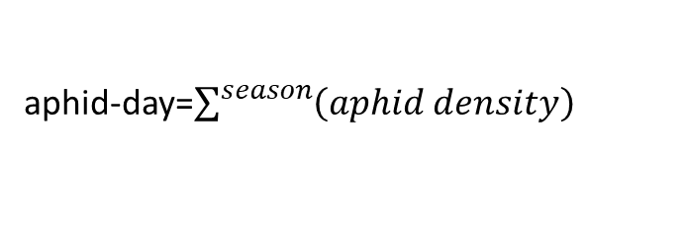
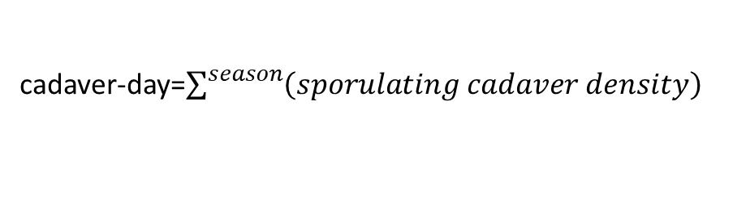
Results: 1 000 runs
aphid-day=$\sum^{season}{\left(aphid density\right)}$
cadaver-day=$\sum^{season}{\left(sporulating cadaver density\right)}$

Slide 22
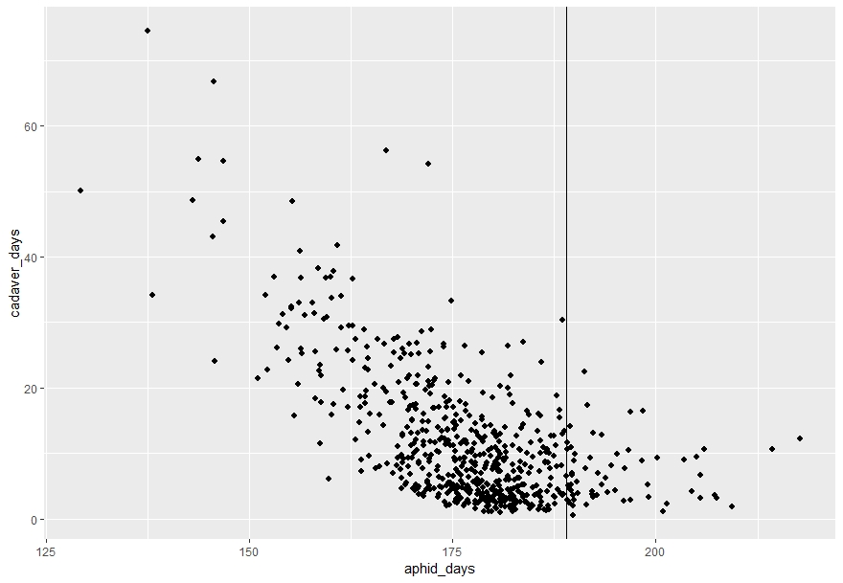
Results: 1 000 runs
aphid-day=$\sum^{season}{\left(aphid density\right)}$
Aphid density reference: model without fungal inoculum
cadaver-day=$\sum^{season}{\left(sporulating cadaver density\right)}$
60
40
Cadaver-days
20
0
125
150
175
200
Aphid-days

Slide 23
Results: 1 000 runs
Aphid density reference: model without fungal inoculum
60
40
Cadaver-days
20
Higher aphid density:
P. neoaphidis causes a higher apterous aphid density, which stay on the wheat.
0
125
150
175
200
Aphid-days

Slide 24
Results: 1 000 runs
Epizootic: «an unusual large number of cases of disease»
Aphid density reference: model without fungal inoculum
60
40
Cadaver-days
20
Higher aphid density:
P. neoaphidis causes a higher apterous aphid density, which stay on the wheat.
0
125
150
175
200
Aphid-days

Slide 25
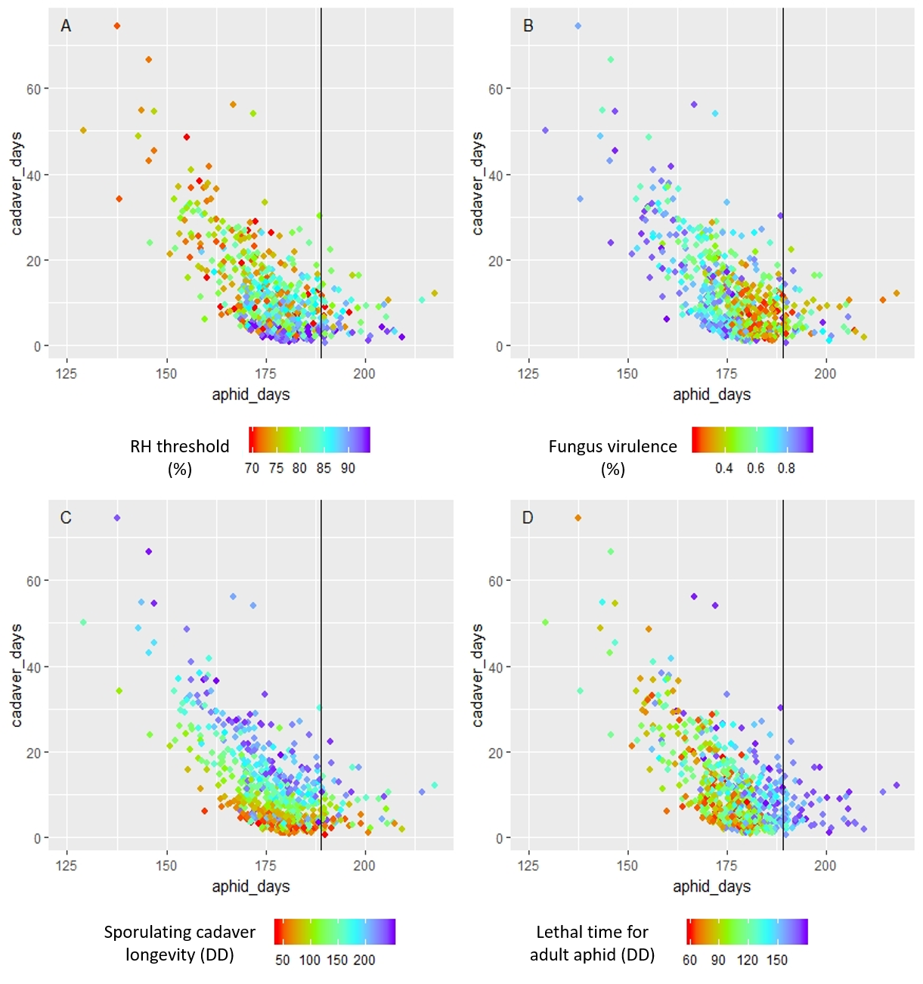
Results: Four most sensitive parameters
Epizootics are characterised by:
a low relative humidity threshold (<83%)

Slide 26
Results: sensitive parameters
Epizootics are characterised by:
a low relative humidity threshold (<83%)
a long longevity of sporulating cadavers in the field (>100 DD)

Slide 27
Results: sensitive parameters
Epizootics are characterised by:
a low relative humidity threshold (<80%)
a long longevity of sporulating cadavers in the field (>100 DD)
a high virulence (>0.6)

Slide 28
Results: sensitive parameters
Epizootics are characterised by:
a low relative humidity threshold (<80%)
a long longevity of sporulating cadavers in the field (>100 DD)
a high virulence (>0.6)
a medium or low lethal time for
adult S. avenae. (<130DD)

Slide 29
2. Weather influence
Uncertainty analysis (21 years)
Parameters set to enable an epizootic unless the weather is not favourable

Slide 30
Uncertainty analysis over 21 years (Ås, Norway)
Parameters | Values
Fungus Biology
RH threshold (%) | 80
Longevity of non-sporulating cadavers (degree-day) | 126
Longevity of sporulating cadavers (degree-day) | 126
Interaction with the aphids
Ratio infected S. avenae immigrants (%) | 50
Fungus virulence (%) | 70
LT infected immigrants (degree-day) | 45
LT infected nymphs (degree-day) | 72
LT infected adults (degree-day) | 73
Infection immunity cost (%) | 30

Slide 31
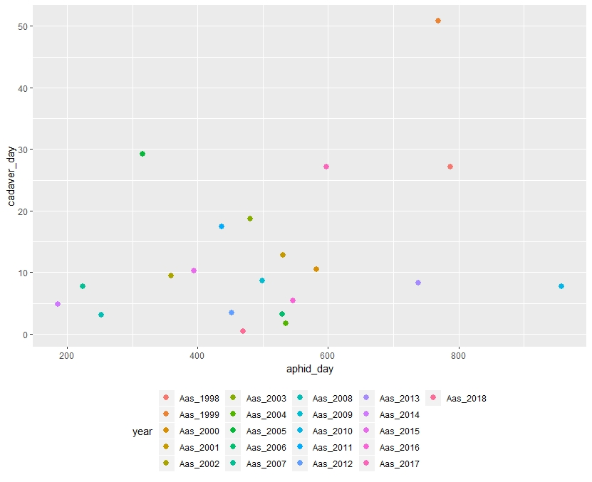
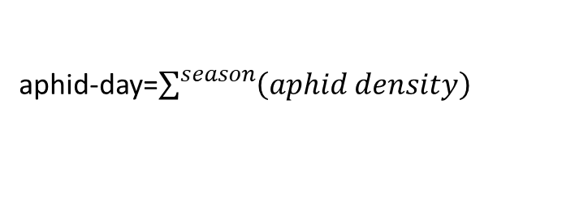
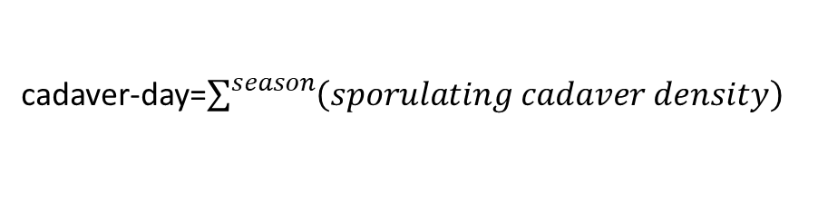
Uncertainty analysis over 21 years (Ås, Norway)
50
40
30
Cadaver-days
20
10
0
200
400
600
800
Aphid-days
aphid-day=$\sum^{season}{\left(aphid density\right)}$
cadaver-day=$\sum^{season}{\left(sporulating cadaver density\right)}$

Slide 32
Uncertainty analysis over 21 years (Ås, Norway)
50
Years favourable for an epizootic
40
30
Cadaver-days
Where to put the limit?
20
10
0
200
400
600
800
Aphid-days

Slide 33
Uncertainty analysis over 21 years (Ås, Norway)
50
Years favourable for an epizootic
40
30
Cadaver-days
Where to put the limit?
20
10
0
200
400
600
800
Aphid-days

Slide 34
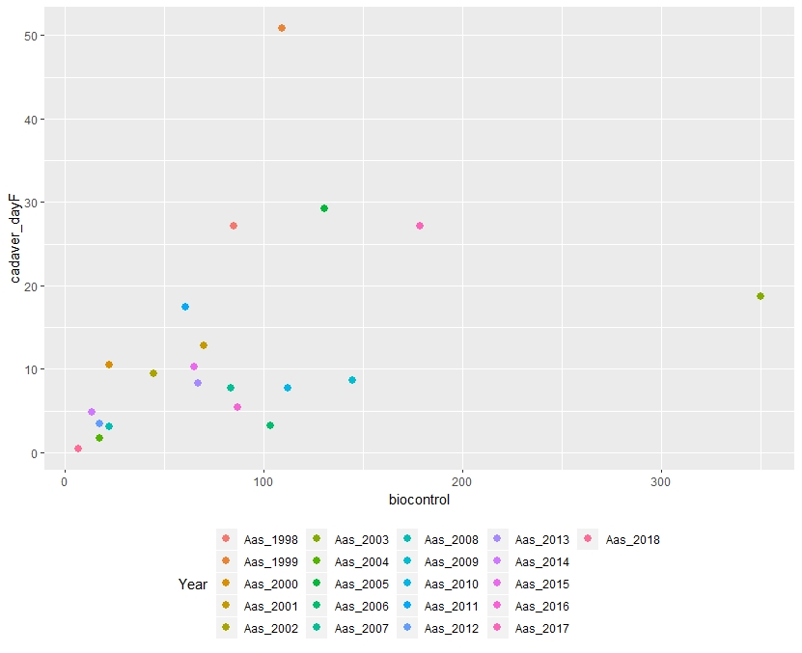
Uncertainty analysis over 21 years (Ås, Norway)
50
40
30
Cadaver-days
20
10
0
0
100
200
300
Biocontrol
biocontrol = aphid-day_{without} _{fungus} – aphid-day_{with} _{fungus}

Slide 35
Uncertainty analysis over 21 years (Ås, Norway)
50
Efficient biological control
40
30
Cadaver-days
20
10
0
0
100
200
300
Biocontrol

Slide 36
Uncertainty analysis over 21 years (Ås, Norway)
50
Efficient biological control
40
30
Cadaver-days
Epizootic
20
10
0
0
100
200
300
Biocontrol

Slide 37
Take home messages
An epizootic is defined as an unusual number of disease cases.
Four parameters influence greatly the probability for an epizootic, namely:
RH threshold
virulence
sporulating cadavers’ longevity
lethal time of adult aphids
The relationship between epizootic and efficient biological control is not straightforward.

Slide 38



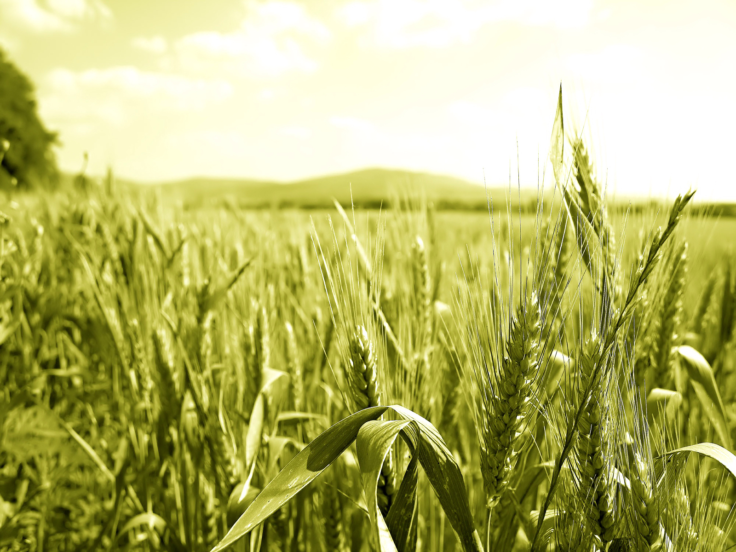
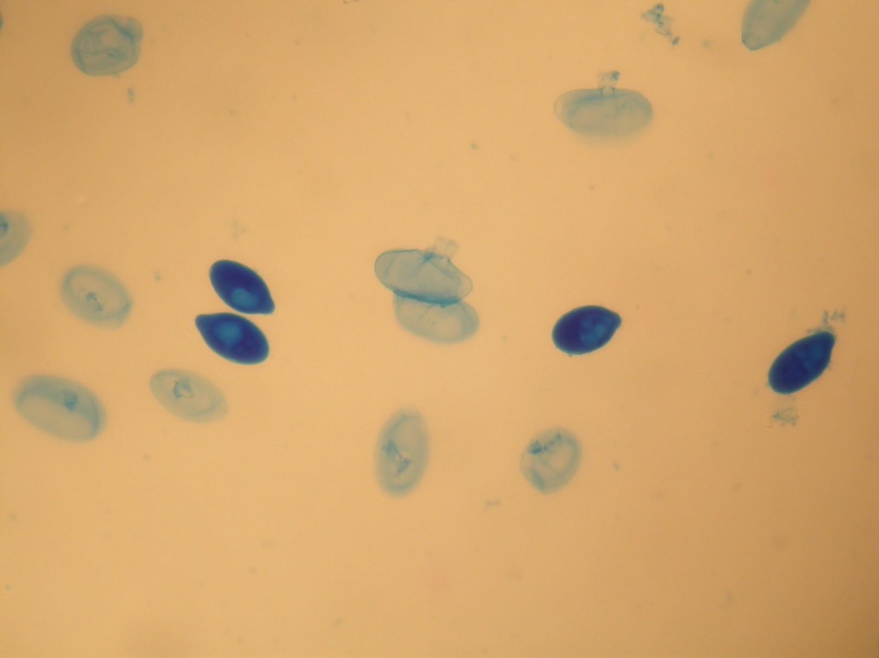

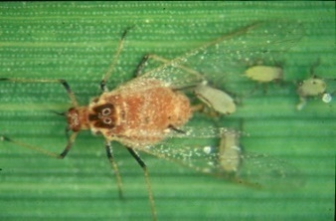
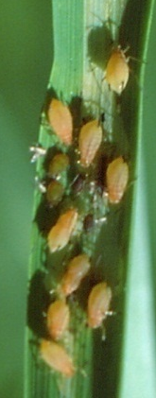



Thank you for your attention!
2015-2019

